Slide 1
Do you know??
You are missing out on 850M¹ pageviews!!!
and
1/3 of visitors¹ close the website after 1 view!!!
1 – https://www.rank2traffic.com/craigslist.org

Slide 2





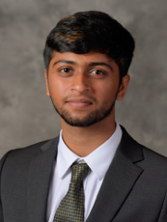

Automate Identification of ‘Best of Craigslist’ posts
Prepared for Craigslist
December 4, 2019
404 Error Name Not Found
Pranay Khandelwal
Samir Husain
Roli Gupta
Arun Ramakrishnan
Shreeansh Priyadarshi

Slide 3

Agenda
Problem Statement and Objectives
Recommendation
Solution 1
Solution 2
Timeline and Risk

Slide 4
Agenda
Solution 1
Recommendation
Solution 2
Problem Statement
and Objectives
Timeline and Risk

Slide 5


Introduction
Background
Problem Statement
Project Objectives
One of the largest peer-to-peer user classifieds website
Presence across more than 500 cities in 70 countries
‘Best of Craigslist’ contains posts nominated by users those are not ‘Best post’ but amusement posts
No provision for <18years
Improve the “Best of Craigslist section”
Mature content filter

Slide 6
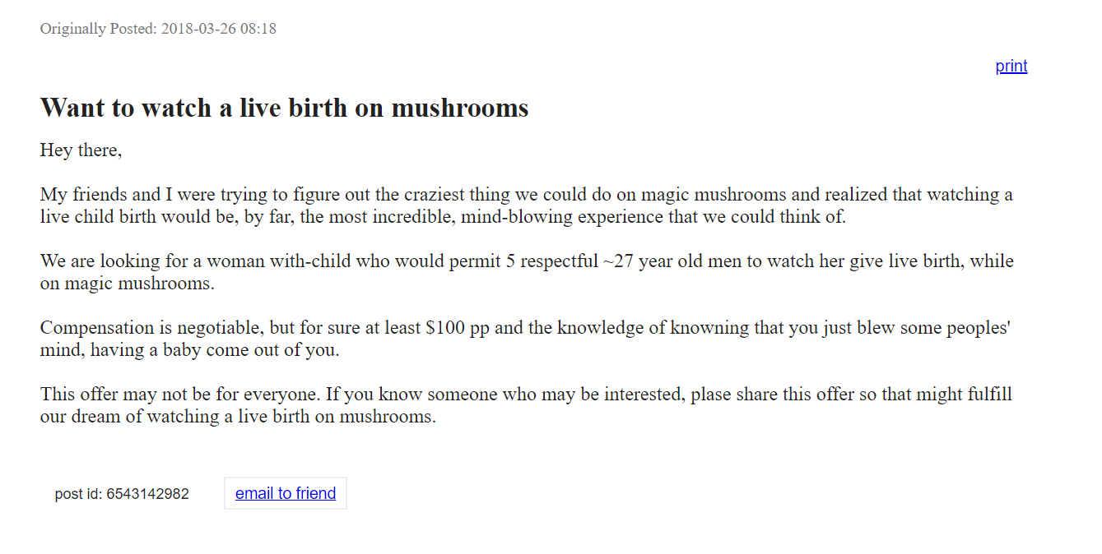

Issues with Craigslist: Qualitative
Irrelevant content on "Best of Craigslist"
Mature content
Although "Best of Craigslist" is aimed towards showcasing the top deals and ads, most posts here end up being catchy or funny in nature to attract the viewers.
Customers often find themselves with mature content. No customization available to block those
*****
This leads to misinformation and bad reviews among customers

Slide 7
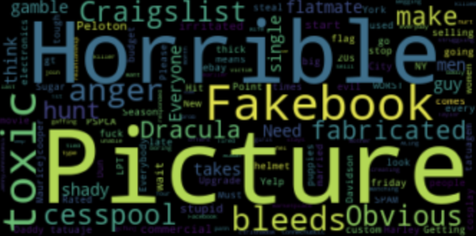
Validate the issues: Quantitative (Twitter)
WordCloud - Craigslist reviews
~20% of Craigslist's customers are discontent
Source: Twitter Numbers and WordCloud in the slide might change based on the changes in the tweets on the internet

Slide 8
Agenda
Solution 1
Recommendation
Solution 2
Problem Statement
and Objectives
Timeline and Risk

Slide 9
Potential solutions to these Issues
Mature content
"Best of Craigslist”
Using text analytics to identify the posts with mature content. This can be done by tweaking the "stop-word" algorithm to flag 18+ words.
Only by clicking on a specific button/icon on the webpage and thus getting user authorization, would the mature content be revealed to the user
Real-time classification of the posts to identify whether they fall into this category or not.
Further, renaming this category to "Amusing posts" so that the customers can better comprehend this category and have realistic expectations from the pages

Slide 10
Agenda
Solution 1
Recommendation
Solution 2
Problem Statement
and Objectives
Timeline and Risk

Slide 11



Detailed Solutions:
Mature content without user authorization
STEP 3
A separate section for mature content posts
STEP 2
Real time analysis of mature posts
STEP 1
Use profanity filters to identify existing posts with mature content
Using the profanity filters , we can identify the mature content into a different section

Slide 12

Lost pageviews due to missing 18+ filter
49.5billion¹
Pageviews on Craigslist annually
17%²
Internet using Americans under the age of 18
Lost views: 850M
10%³
of users visit ‘Best of Craigslist’ section
1 - https://www.rank2traffic.com/craigslist.org
2 - https://www.census.gov/prod/cen2010/briefs/c2010br-03.pdf
3 – Ballpark assumption

Slide 13
Agenda
Solution 1
Recommendation
Solution 2
Problem Statement
and Objectives
Timeline and Risk

Slide 14

Detailed Solution:
Irrelevant content on "Best of Craigslist"
‘Best of Craigslist’ are actually posts that users have voted to be interesting or amusing
We will use this classification as indicator for virality
Scrape regular posts from regional domains and all the ‘Best Posts’
Assign these posts target values of 0 and 1. We then build a classification model using post description
The model can then recommend new posts in real-time that users might find interesting

Slide 15





Analysis: Flowchart
Tokenize, Lemmatize, Stop- words removal and Tf-IDF vectorize
Test various models
Scrape Craigslist’s Best featured and non-features posts
Cross-validation is done
Model is finalized based on cross-validation set

Slide 16


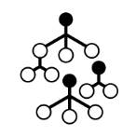
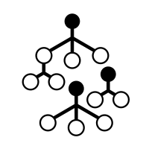
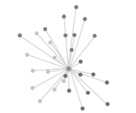
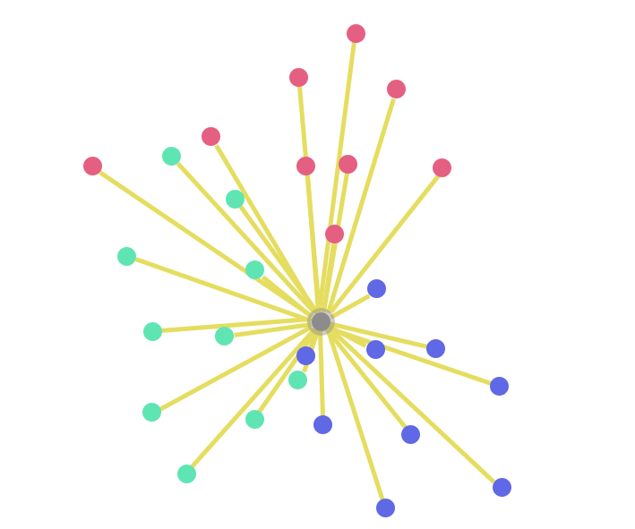



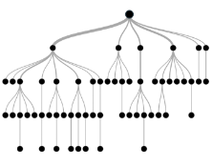

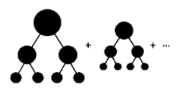


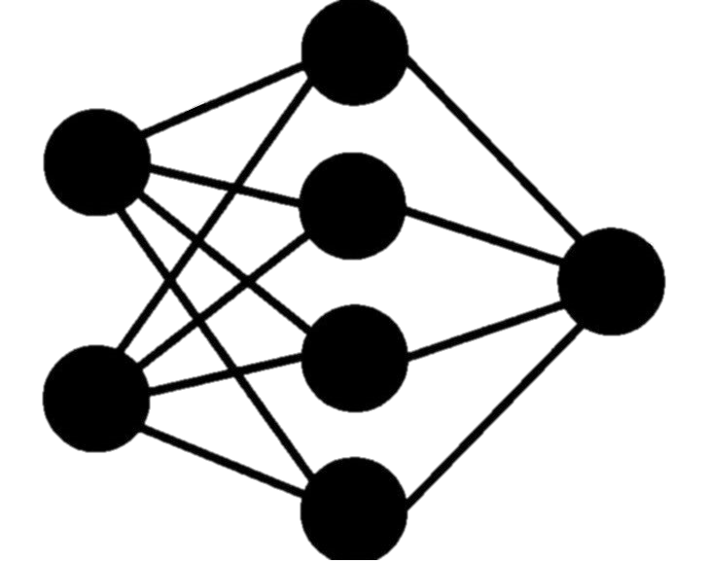
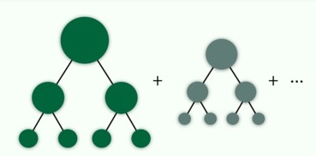
Data modeling techniques applied
AUC: 89.3%
AUC: 87.8%
AUC: 89.0%
AUC: 71.6%
AUC: 87.1%
Logistic Regression
Support Vector Machines
Random Forest Classifier
KNN Classifier
Naïve Bayes
AUC: 84.8%
AUC: 90.1%
AUC: 88.9%
AUC: 90.3%
AUC: 92.6%
Decision Tree Classifier
Gradient Boosting Classifier
Adaboost Classifier
Deep Neural Network
LSTM
These are post optimization results

Slide 17




Impact
In the future, if craigslist decides to show ads, the
website could earn $150mn¹ in revenue.
Increase traffic
Boost time on site
Predict virality of new craigslist posts
Random post generation feature
Funny Post → more people to the website
Add button ‘cool’ posting → increases user spend time
Our model can be used to generate
personalized recommendations
when trained on data of posts visited by any user
1 - https://www.rank2traffic.com/craigslist.org

Slide 18
Agenda
Solution 1
Recommendation
Solution 2
Problem Statement
and Objectives
Timeline and Risk

Slide 19




Project Execution
PROCESSES
Amusing post recommender
Mature content filter across website
PEOPLE
Website design to reduce confusion
New feature to retain users for longer
TECHNOLOGY
Machine learning models to learn what makes a post go viral
NLP to identify mature content

Slide 20
Risk and Risk mitigation
Deviation from conventional style
NLP challenges
Market Survey to understand the attitude of customers towards proposed changes
Sarcastic comments and posts can be identified in future through extensive research and development
Operational Cost Increase
Object Detection
Partnering with BA courses across countries to utilize young talents
Posts with misclassified objects can be reclassified through advanced object detection

Slide 21
Timeline
Build the infrastructure
Utilize AWS/GCP for cheap data storage
Develop data streams from Craigslist website to cloud , analysis and generating reports
Develop scheduled web scraping from Twitter
1
2
0-3mos
6-9mos
Internal Alignment
Identify and validate the issue
Define metrics to quantify impact
Develop team of data engineers and data scientists
3
Roll-out and Replicate
Roll-out the website changes to the customers (potentially with a new website design launch)
Develop plan to replicate the changes across other Craigslist's categories
4
Evaluate and Refine
First wave of the end-to-end analysis is done
Potential areas of improvement identified
Evaluation metric calculated and ready to be tracked across upcoming months
10-12mos
12+mos

Slide 22




Final Recommendation Slides
‘Waste my time’ button to show random ‘Best post’
DevOps effort
+
Data collection policy update
Increased traffic and time spent on site
NSFW filter switch on website and search results
Data collection for personalized post recommendation
Long-term Solution
Improved user satisfaction and serve more people
Invest in R&D, develop solutions to move from “information” to “recommendation” architecture

Slide 23

APPENDIX

Slide 24
Appendix

Slide 25
Project analysis slide 10
Performance of models before/after tuning
90.3%
90.1
89.7
89.6
89.4
88.8%
89.1%
88.9
AUC
88.3%
88.4%
Adaptive Boost
Random Forest
Logistic Regression
Gradient Boost
DNN

Slide 26
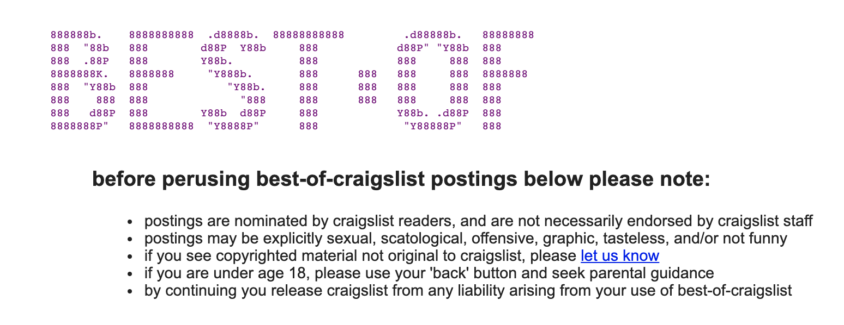
Project analysis slide 10
Filtering 18+

